Slide 1

Eliminating State Entanglement with Checkpoint-Based Virtualization of Mobile OS Services
Kevin Boos Ardalan Amiri Sani Lin Zhong

Slide 2
What is State Entanglement?
Background
Application-relevant states stored outside of the application process
Notes:
Now what does this really mean?
Let’s first take a look at the classic way that applications access system functionality, the shared library model.

Slide 3
Shared Library Model
Background
Client Process
Application
All states in one process
Shared Library
syscall
Linux Kernel

Slide 4
Mobile OS Service Model
Background
microkernel … ish
Client Process
OS Service Process
Application
System Service
IPC
syscall
State Entanglement!
Linux Kernel
States spread across multiple processes
Notes:
Interestingly, this service model results in an OS that quite resembles the structure of a microkernel! In a microkernel, various “servers” run in separate processes and communicate via IPC.

Slide 5
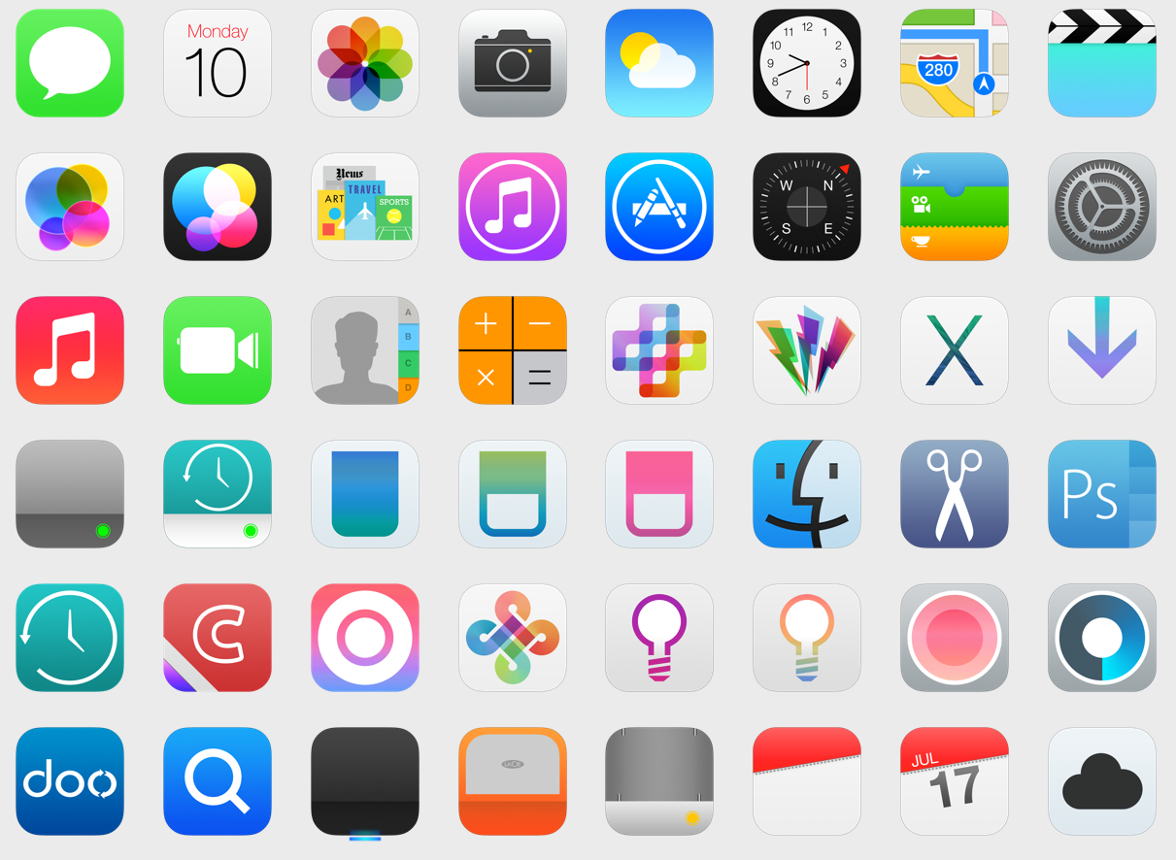
Why do we care?
Motivation
What is our larger goal?
Users are only interested in states from their applications
What can’t we do because of state entanglement?
Fault isolation
Fault tolerance
Application migration
Live update
Application speculation
Notes:
So now that you know what state entanglement is, you might be wondering why we care about it.
We will revisit these use cases throughout the talk.
In the interest of time, I’m only going to discuss the first 3, please refer to the paper for a discussion of live update and application speculation.

Slide 6



Problems – Fault Isolation
Problems
OS Service
OS Service
App A
App A
App A affects App B through the OS Service
App B
App B
Notes:
If App A compromises a service or causes the service it’s using to crash, any other apps using that service will also experience failures.

Slide 7
Problems – Fault Tolerance
Problems
OS Service
OS Service
OS Service _{t-1}
OS Service _{t-2}
App A
OS Service _{t-3}
App B
?
A fault recovery for App A unexpectedly breaks App B
Notes:
Fault tolerance is similar. If App A is using a service that crashes, to get that service back online would require restoring it to an earlier working state.
This would break App B because App B does not expect the service’s state to change suddenly.

Slide 8

Problems – App Migration
Problems
App
Post-migration, App A cannot continue using OS Service
OS Service
OS Service
?
original device
target device

Slide 9

Solution: OS Service Virtualization
Notes:
Our solution for detangling this mess of states is OS Service Virtualization.

Slide 10
OS Service Virtualization
Design
Virtualize an OS Service on a per-app basis
N to 1 → 1 to 1
Encapsulate only one app’s states in a service
Disentangles states
App A
OS Service _{A}
Cannot instantiate a service multiple times!
App B
OS Service _{B}
App N
OS Service _{N}
Notes:
In a practical sense, you cannot create multiple instances of the same service because other OS facilities, like the kernel and other services, expect each service to be a Singleton.

Slide 11
Corsa: Checkpoint-based Virtualization
Design
Virtualization through checkpoint/restore
Intercept app-service transactions
Per-app checkpoint history
Only one active instance
All other OS bodies see a single service instance
Preserves legacy expectations
OS Service
Virtual Service _{A}
App A
Current
App B
Virtual Service _{A}
Virtual Service _{B}
Base Checkpoint
Virtual Service _{N}
App N
Base Checkpoint
Eliminates state entanglement
No knowledge of virtualized entity
Notes:
We have 2 apps that want to use an OS Service.
We start with a Base checkpoint, which is taken right after the service is initialized but before any app has used it.
[Describe animation process.]
App A uses service, App B uses it, switch back to App A.

Slide 12

Corsa Enables Fault Isolation
Design
OS Service
App A
App A
Virtual Service _{A}
Virtual Service _{A}
App B is unaffected by App A’s failures
App B
Virtual Service _{B}
Notes:
If App A compromises a service or causes the service it’s using to crash, any other apps using that service will also experience failures.

Slide 13
Corsa Enables Fault Tolerance
Design
OS Service
App A
Virtual Service _{A}
Virtual Service _{A}
Virtual Service _{A-2}
Virtual Service _{A-3}
Virtual Service _{A-1}
App B
Virtual Service _{B}
Recovering a service for App A does not break App B
Notes:
Fault tolerance is similar. If App A is using a service that crashes, to get that service back online would require restoring it to an earlier working state.
This would break App B because App B does not expect the service’s state to change suddenly.

Slide 14
Corsa Enables App Migration
Design
App
Post-migration, App A can continue using OS Service with all states intact
OS Service
OS Service
original device
target device

Slide 15
Ongoing Implementation
Implementation
Checkpointing software is an implementation choice
Kernel-based checkpoint/restore mechanism
Checkpoint: duplicates process structures, COW
Restore: swaps process control block pointers
Triggered upon intercepted Binder IPC transactions
Must monitor both sides of transaction, proxy and stub
Key insight: Checkpoint and Restore can be parallelized
Optimization: checkpoint can be slow, restore must be fast
Only restore is on the critical path of an application transition

Slide 16
Feasibility
Feasibility
Is checkpoint/restore a feasible means of virtualization?
Time to checkpoint a service
Time to restore a service checkpoint
Interval between two one-shot transactions
Frequency of periodic transactions
t_{C}
t_{R}
Key Measurements
Nexus 5 + Android 5.0
θ
f
Notes:
Is the overhead of checkpoint/restore too much?
We have four key measurements, and I’ll discuss just the first 3 today.

Slide 17
Feasibility
Feasibility
App A
(Opening App)
idle
App B
idle
Critical Path!
(Launcher)
OS Service
(SurfaceFlinger)
Transaction B
C/R
Transaction A
𝜃
t_{C} + t_{R}
1.07 ms
0.3 ms
4.4 µs

Slide 18
Feasibility
Feasibility
App A
(Opening App)
idle
App B
idle
Min. Delay
(Launcher)
OS Service
(SurfaceFlinger)
Transaction B
ckpt
R
Transaction A
t_{C}
t_{R}
proactive
parallel
async
Notes:
We want to minimize the delays we insert into the critical path, to just a restore operation.
One optimization to shorten the critical path is proactively taking a checkpoint before the next application even accesses the service.
Note that these are not to scale. Restore is about 100 times faster than checkpoint.
A better optimization stems from the observation that a checkpoint operation can actually be done in parallel with the restore operation, or asynchronously afterwards.
There are additional feasibility measurements in the paper, for example, how

Slide 19
Related Work at a glance
Related Work
Virtualization: a choice of boundary and granularity
Whole-system VMs, OS-level, process-level, and more
Record & Replay: temporally and spatially less efficient
Flux: app migration through selective R&R
Memory Protection: provides foundations of isolation
Relies on manual knowledge and identification of states
Manual Modification: deep understanding + tedious engineering effort

Slide 20
Discussion
Wrap Up
Limited scope: interactions between apps and OS Services
State entanglement also manifests in other layers
Each layer requires its own solution because states are fundamentally different
Permitted Modification | Potential
No modifications | Preserve legacy compatibility
Entities themselves | ≈ Manual disentanglement
Layers beneath the entities | Disentangle unmodified higher levels
Clean slate OS rewritten from scratch | ∞
Stateless entities, à la RESTFUL web services

Slide 21
Concluding Remarks
Wrap Up
State entanglement: app-specific states stored in service processes
Root cause behind barriers to target use cases
Corsa: virtualizes OS Services on a per-app basis
Virtualization solution implemented via checkpoint/restore
Full implementation in progress, slated for early 2016
Kevin Boos kevinaboos@rice.edu
www.owlnet.rice.edu/~kevinaboos
Notes:
To wrap things up, we identify the problem of State Entanglement, one incarnation of which occurs between applications and OS Services on mobile operating systems.

Slide 22
Mobile OS Service Model
Client Process
OS Service Process
Application
Mgr Proxy
Stub
System Service
IPC
syscall
Linux Kernel
State Entanglement!
Notes:
In a real-world OS like Android, things are a bit more complicated.
A manager proxy helps the application communicate with the service process through an RPC-like stub.
Both of these entities will also harbor app-specific states.
Overall, we classify this problem as state entanglement.

